Slide 1
Lecture 4_Security Attacks

Slide 2
Outline
Security attacks in X.800
Security services

Slide 3
Passive attack
i.e. eavesdropping on or monitoring of transmissions
Goal: obtain information being transmitted
release of message contents
traffic analysis – a promiscuous sniffer
Very difficult to detect – no alteration of the data
But easy to prevent, why?

Slide 4
Active attack
active attack includes:
Masquerade
replay
Modification of messages
Denial of service

Slide 5
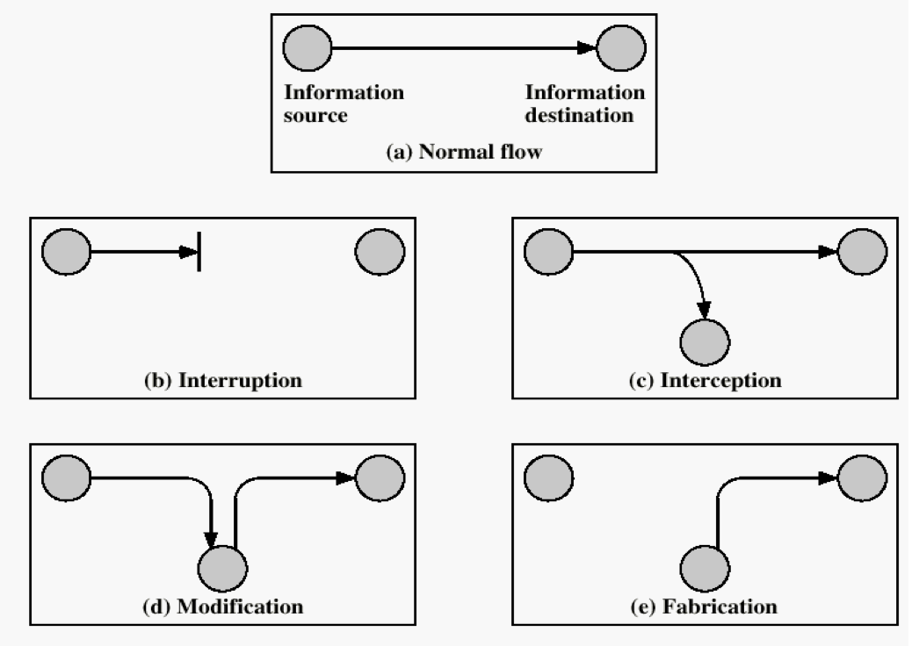
Example: two points communication
Generic types of attacks

Slide 6
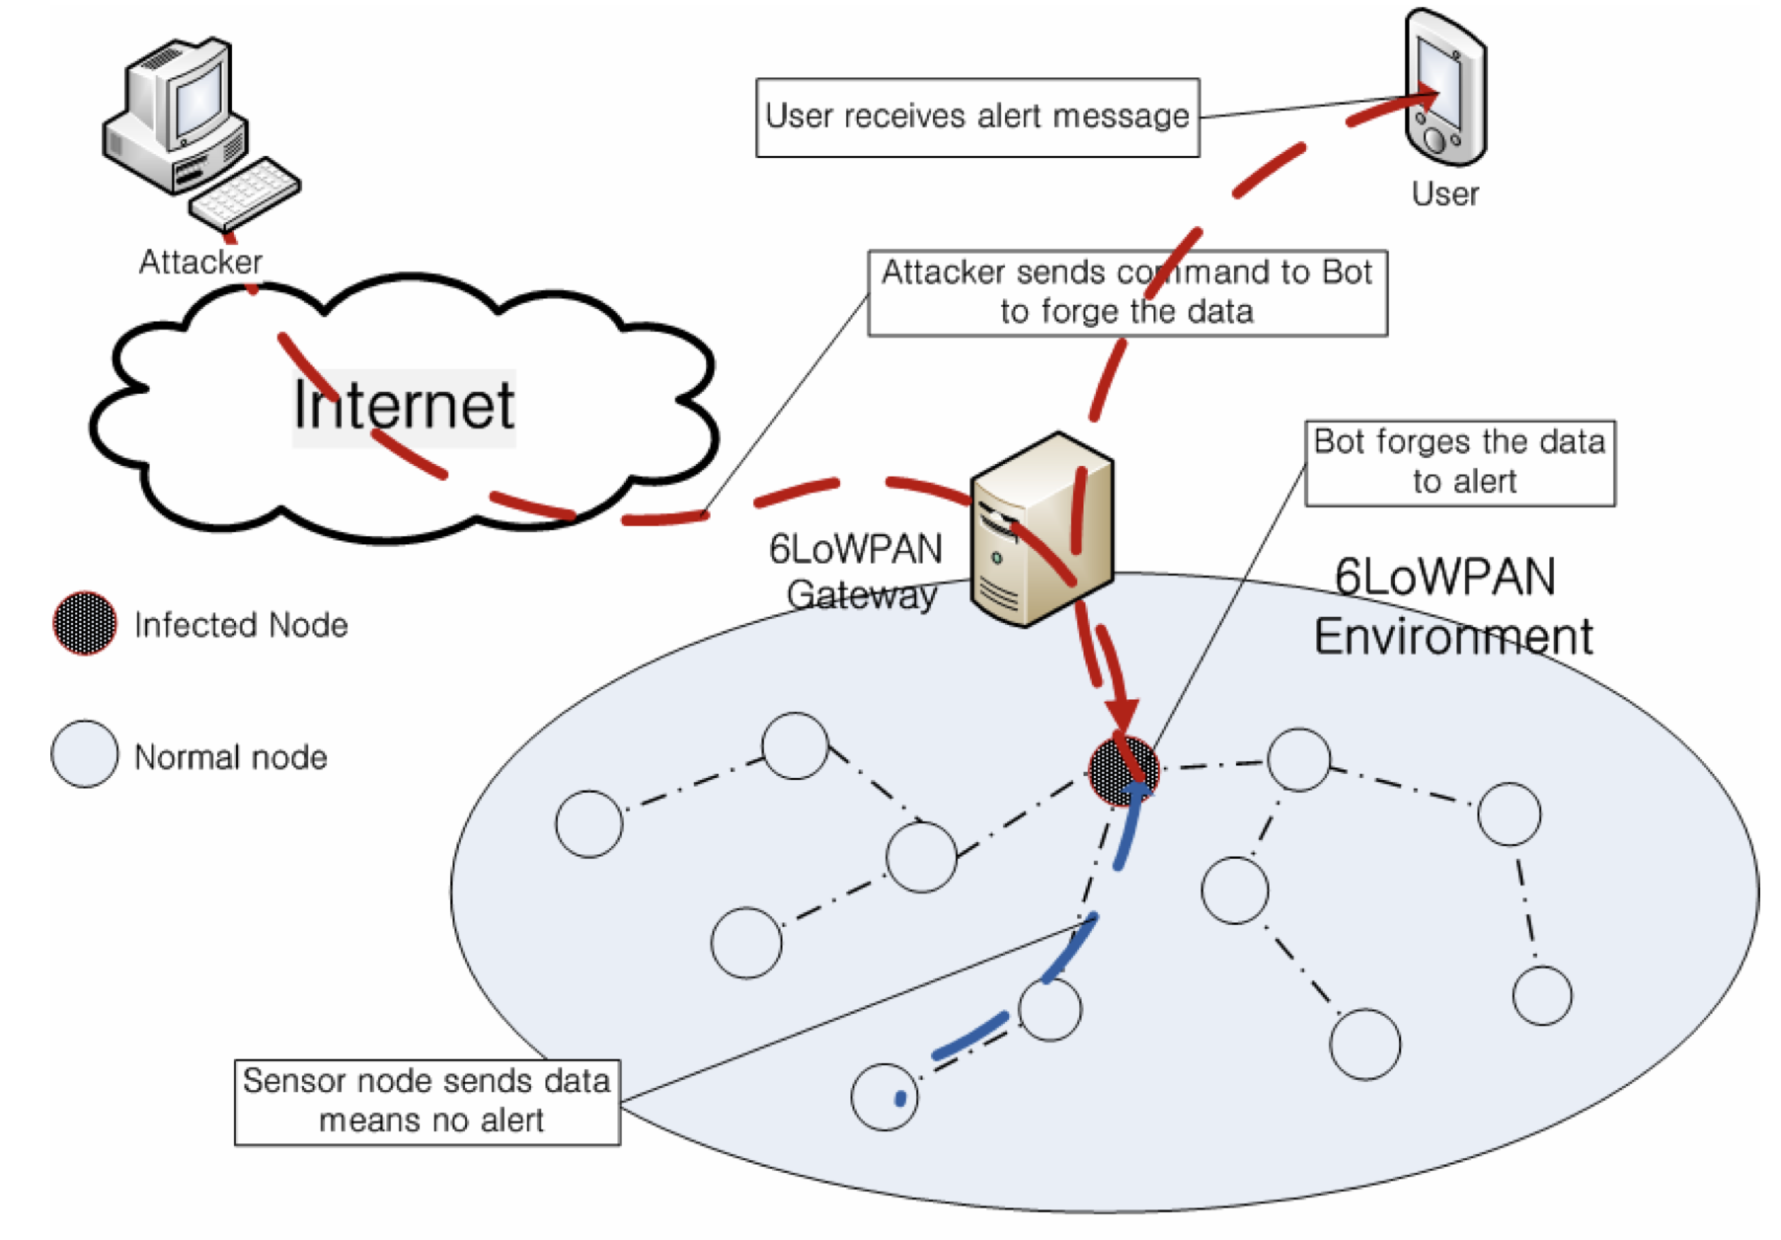
Example of modification attack in 6LoWPAN

Slide 7
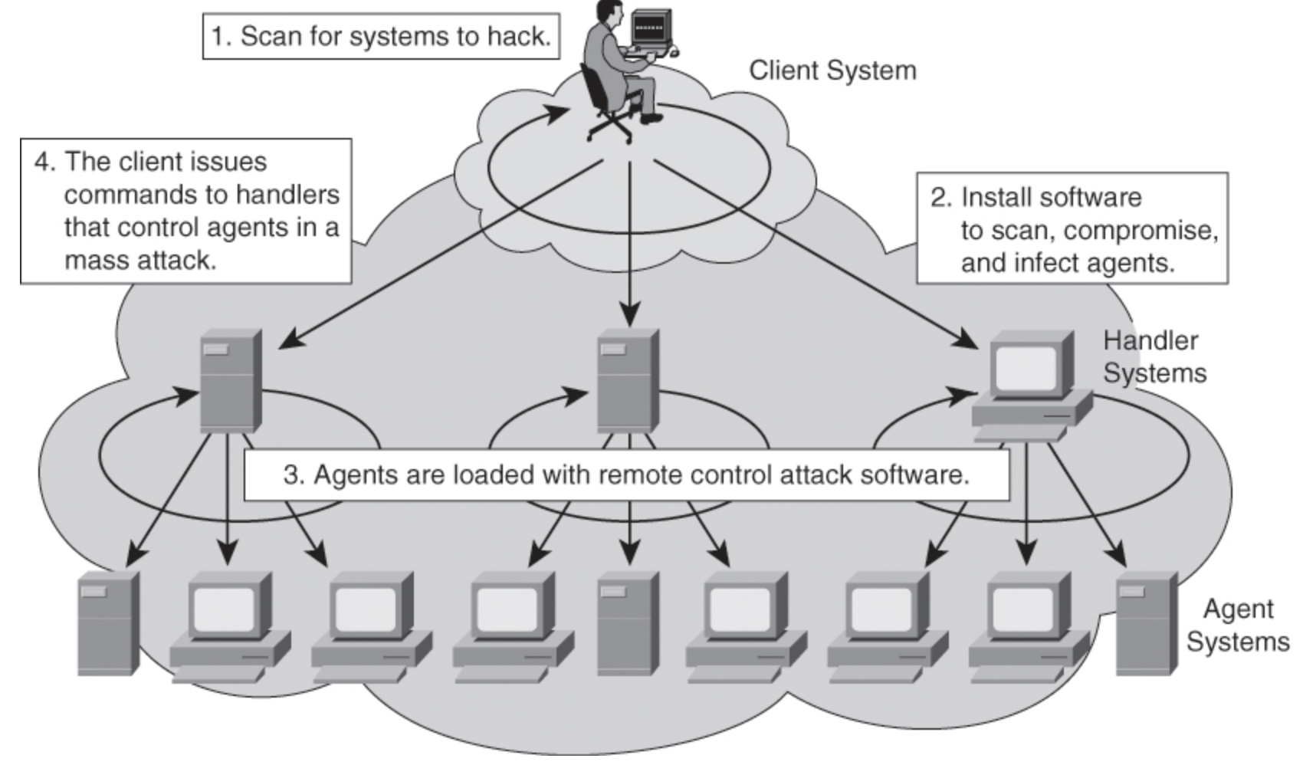
Example: a group of attackers

Slide 8
Know Your Threat Model
Threat model: A model of who your attacker is and what resources they have
One of the best ways to counter an attacker is to attack their reasons

Slide 9
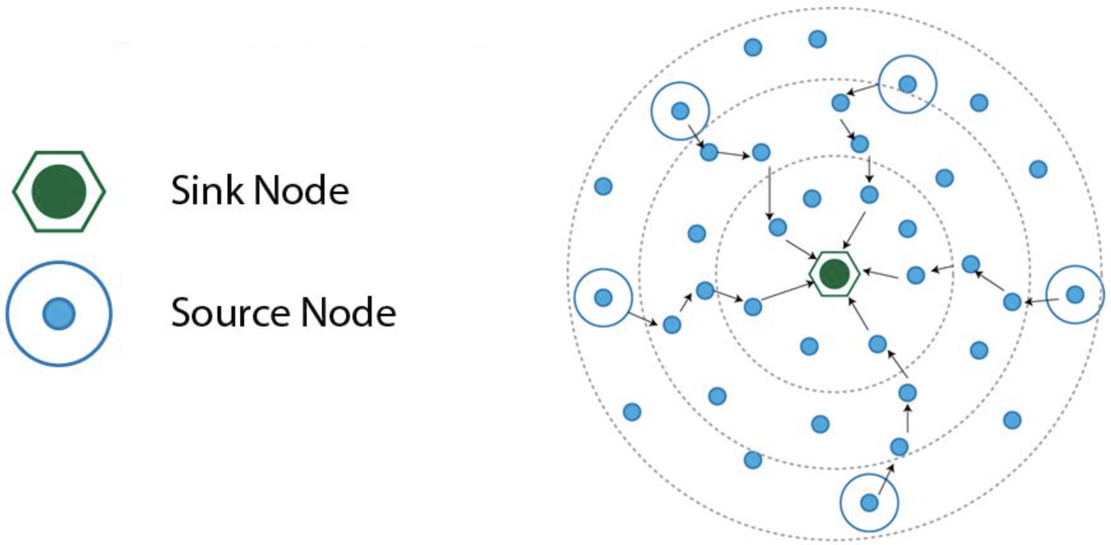
Example: adversary model
“The adversary is assumed to be intelligent and has limited number of resources. Before capturing the nodes, it exploits the various vulnerabilities of the networks. It knows the topology of the network, routing information. It aims to capture the sink node so as to disrupt the whole traffic. If it is not able to capture the sink node, it will capture the nearby nodes of the sink. It tries to disrupt the whole traffic of the network with minimum number of captured nodes. It is also assumed that the adversary tends to attack more on the nodes closer to the data sink than nodes that are far away”
Notes:
IPv6 over Low-Power Wireless Personal Area Networks

Slide 10
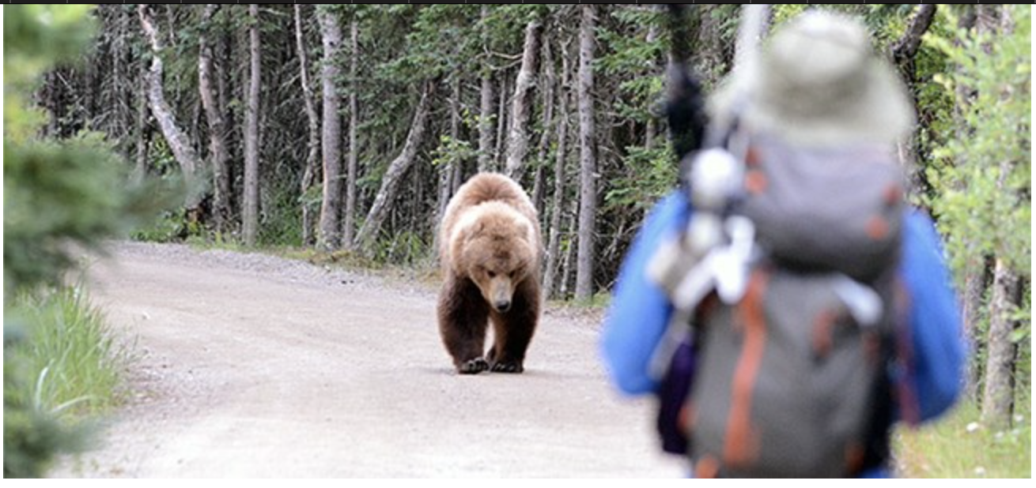
Story…
The bear race
Takeaway: Even if a defense is not perfect, it is important to always stay on top of best security measures
I don’t have to outrun the bear. I just have to outrun you

Slide 11
Design in security from the start
When building a new system, include security as part of the design considerations rather than patching it after the fact
A lot of systems today were not designed with security from the start, resulting in patches that don’t fully fix the problem!
Keep these security principles in mind whenever you write code!

Slide 12
Human Factors
The users
Users like convenience (ease of use)
If a security system is unusable, it will be unused
Users will find way to subvert security systems if it makes their lives easier
The programmers
Programmers make mistakes
Programmers use tools that allow them to make mistakes (e.g. C and C++)
Everyone else
Social engineering attacks exploit other people’s trust and access for personal gain

